Slide 1
Stack and Queue
Mrs. Sonali V. Shinge

Slide 2
Stack
Stack is a linear data structure that follows a particular order in which the operations are performed.
The order may be LIFO(Last In First Out) or FILO(First In Last Out).
LIFO implies that the element that is inserted last, comes out first and FILO implies that the element that is inserted first, comes out last.

Slide 3
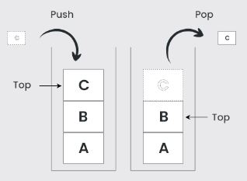

Slide 4
Basic Operations on Stack
push() to insert an element into the stack
pop() to remove an element from the stack
top() Returns the top element of the stack.
isEmpty() returns true if stack is empty else false.
isFull() returns true if the stack is full else false.

Slide 5
Push Operation on Stack
Adds an item to the stack. If the stack is full, then it is said to be an Overflow condition.
Algorithm for Push Operation:
Before pushing the element to the stack, check if the stack is full .
If the stack is full (top == capacity-1) , then Stack Overflows and cannot insert the element to the stack.
Otherwise, increment the value of top by 1 (top = top + 1) and the new value is inserted at top position .
The elements can be pushed into the stack till reach the capacity of the stack.

Slide 6
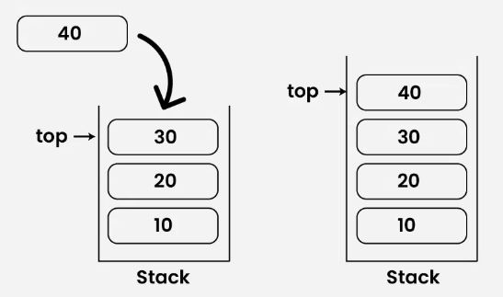

Slide 7
Pop Operation in Stack
Removes an item from the stack. The items are popped in the reversed order in which they are pushed. If the stack is empty, then it is said to be an Underflow condition.
Algorithm for Pop Operation:
Before popping the element from the stack, check if the stack is empty .
If the stack is empty (top == -1), then Stack Underflows and cannot remove any element from the stack.
Otherwise, store the value at top, decrement the value of top by 1 (top = top – 1) and return the stored top value.

Slide 8
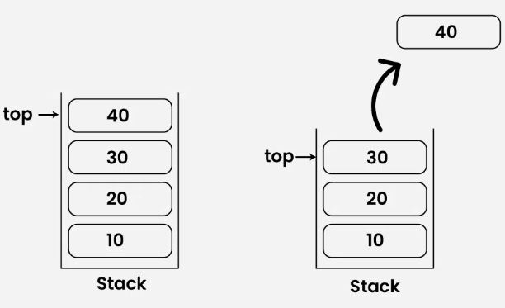

Slide 9
Top or Peek Operation on Stack
Returns the top element of the stack.
Algorithm for Top Operation:
Before returning the top element from the stack, check if the stack is empty.
If the stack is empty (top == -1), simply print “Stack is empty”.
Otherwise, return the element stored at index = top .

Slide 10
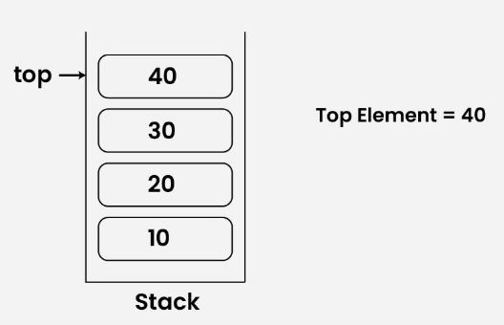

Slide 11
isEmpty Operation in Stack
Returns true if the stack is empty, else false.
Algorithm for isEmpty Operation:
Check for the value of top in stack.
If (top == -1), then the stack is empty so return true .
Otherwise, the stack is not empty so return false .

Slide 12
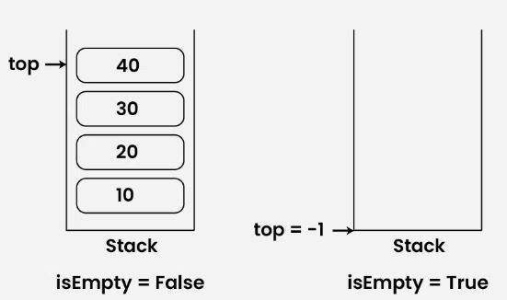

Slide 13
isFull Operation in Stack
Returns true if the stack is full, else false.
Algorithm for isFull Operation:
Check for the value of top in stack.
If (top == capacity-1), then the stack is full so return true.
Otherwise, the stack is not full so return false.

Slide 14
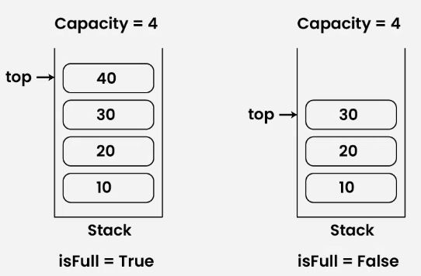

Slide 15
Operations | Time Complexity | Space Complexity
push() | O(1) | O(1)
pop() | O(1) | O(1)
top() or peek() | O(1) | O(1)
isfull() | O(1) | O(1)
isempty() | O(1) | O(1)

Slide 16
Applications of Stacks
Function calls: Stacks are used to keep track of the return addresses of function calls, allowing the program to return to the correct location after a function has finished executing.
Recursion: Stacks are used to store the local variables and return addresses of recursive function calls, allowing the program to keep track of the current state of the recursion.
Expression evaluation: Stacks are used to evaluate expressions in postfix notation (Reverse Polish Notation).
Syntax parsing: Stacks are used to check the validity of syntax in programming languages and other formal languages.
Memory management: Stacks are used to allocate and manage memory in some operating systems and programming languages.

Slide 17
Expression Evaluation
Infix Notation: Operators are written between the operands they operate on, e.g. A + B.
Prefix Notation: Operators are written before the operands, e.g + A B
Postfix Notation: Operators are written after operands.
e.g AB+

Slide 18
Conversion of infix to postfix
The steps to convert infix to postfix expression:
Scan the infix expression from left to right.
If the scanned character is an operand, put it in the postfix expression.
Otherwise, do the following
If the precedence of the current scanned operator is higher than the precedence of the operator on top of the stack, or if the stack is empty, or if the stack contains a ‘(‘, then push the current operator onto the stack.
Else, pop all operators from the stack that have precedence higher than or equal to that of the current operator. After that push the current operator onto the stack.

Slide 19
If the scanned character is a ‘(‘, push it to the stack.
If the scanned character is a ‘)’, pop the stack and output it until a ‘(‘ is encountered, and discard both the parenthesis.
Repeat steps 2-5 until the infix expression is scanned.
Once the scanning is over, Pop the stack and add the operators in the postfix expression until it is not empty.
Finally, print the postfix expression.

Slide 20
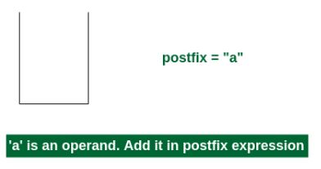
infix expression exp = a+b*c+d
1st Step: Here i = 0 and exp[i] = ‘a’ i.e., an operand. So add this in the postfix expression. Therefore, postfix = “a”.

Slide 21
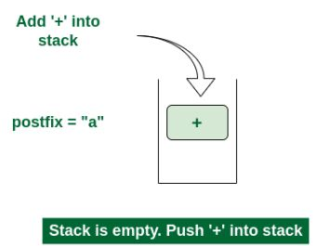
2nd Step: Here i = 1 and exp[i] = ‘+’ i.e., an operator. Push this into the stack. postfix = “a” and stack = {+}.

Slide 22
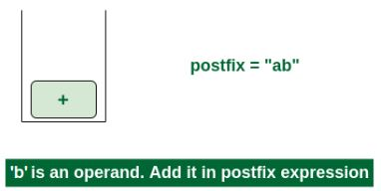
3rd Step: Now i = 2 and exp[i] = ‘b’ i.e., an operand. So add this in the postfix expression. postfix = “ab” and stack = {+}.

Slide 23
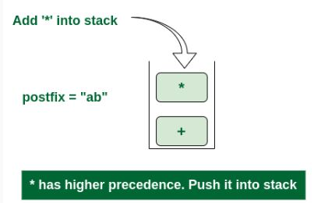
4th Step: Now i = 3 and exp[i] = ‘*’ i.e., an operator. Push this into the stack. postfix = “ab” and stack = {+, *}.

Slide 24
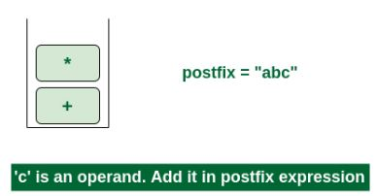
5th Step: Now i = 4 and exp[i] = ‘c’ i.e., an operand. Add this in the postfix expression. postfix = “abc” and stack = {+, *}.

Slide 25
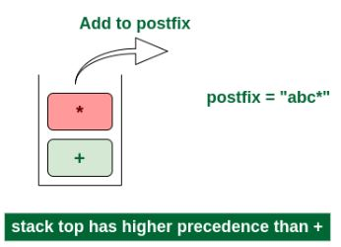
6th Step: Now i = 5 and exp[i] = ‘+’ i.e., an operator. The topmost element of the stack has higher precedence. So pop until the stack becomes empty or the top element has less precedence. ‘*’ is popped and added in postfix. So postfix = “abc*” and stack = {+}.

Slide 26
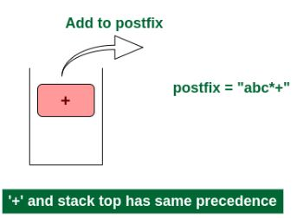
Now top element is ‘+‘ that also doesn’t have less precedence. Pop it. postfix = “abc*+”.

Slide 27
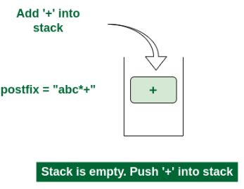
Now stack is empty. So push ‘+’ in the stack. stack = {+}.

Slide 28
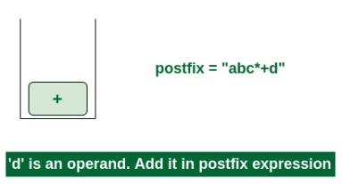
7th Step: Now i = 6 and exp[i] = ‘d’ i.e., an operand. Add this in the postfix expression. postfix = “abc*+d”.

Slide 29
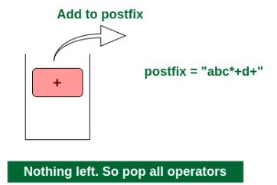
Final Step: Now no element is left. So empty the stack and add it in the postfix expression. postfix = “abc*+d+”.

Slide 30
Evaluation of Expression
Convert the expression in Reverse Polish notation( post-fix notation).
Push the operands into the stack in the order they appear.
When any operator encounters then pop two topmost operands for executing the operation.
After execution push the result obtained into the stack.
After the complete execution of expression, the final result remains on the top of the stack.

Slide 31
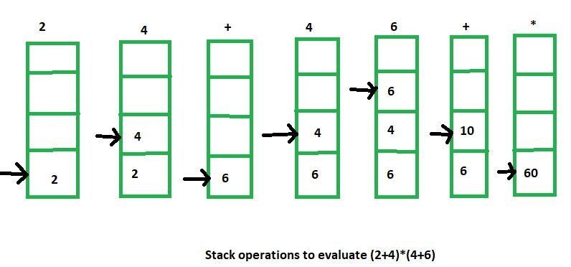
Infix notation: (2+4) * (4+6)
Post-fix notation: 2 4 + 4 6 + *

Slide 32
Conversion of infix to prefix

Slide 33
Reverse the infix expression. Note while reversing each ‘(‘ will become ‘)’ and each ‘)’ becomes ‘(‘.
Convert the reversed infix expression to postfix expression.
Initialize an empty stack to store operators and an empty string for the postfix expression.
Scan the infix expression from left to right.
If the character is an operand, append it to the postfix expression.
If the character is ‘(‘, push it onto the stack.
If the character is ‘)’, pop from the stack and append to the postfix expression until ‘(‘ is found, then pop ‘(‘ without appending.
If the character is an operator, pop and append operators from the stack until the stack is empty or a lower precedence operator is found, then push the current operator onto the stack.
After scanning the expression, pop and append all remaining operators from the stack to the postfix expression.
Reverse the postfix expression and return it.

Slide 34
Queue

Slide 35
Introduction
A Queue Data Structure is a fundamental concept in computer science used for storing and managing data in a specific order.
Queue is a linear data structure.
It follows the principle of "First in, First out" (FIFO), where the first element added to the queue is the first one to be removed.
Queues are commonly used in various algorithms and applications for their simplicity and efficiency in managing data flow.

Slide 36
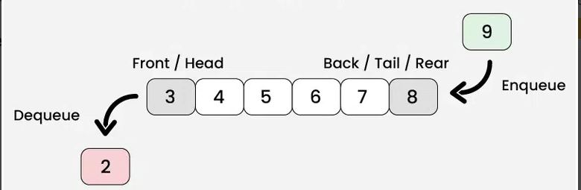

Slide 37
Operations on Queue
1. Enqueue:
Enqueue operation adds (or stores) an element to the end of the queue.
Algorithm
check if the queue is full
for the first element, set the value of FRONT to 0
increase the REAR index by 1
add the new element in the position pointed to by REAR

Slide 38
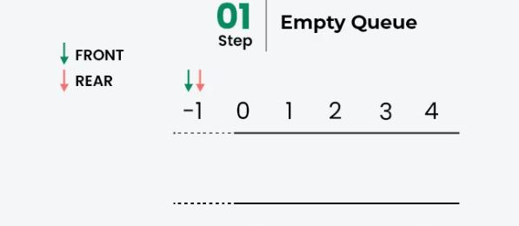

Slide 39
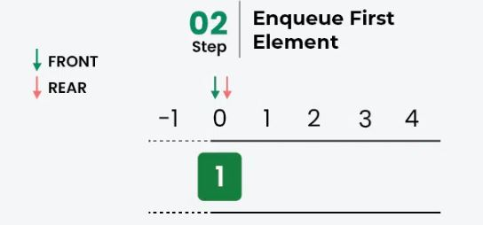

Slide 40
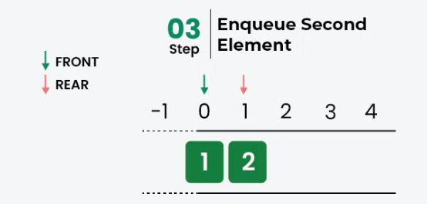

Slide 41
2. Dequeue:
Dequeue operation removes the element at the front of the queue.
Algorithm:
check if the queue is empty
return the value pointed by FRONT
increase the FRONT index by 1
for the last element, reset the values of FRONT and REAR to -1

Slide 42
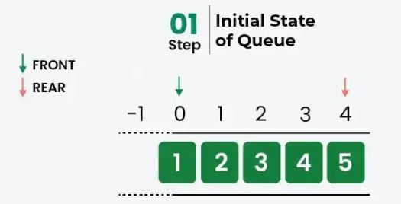

Slide 43
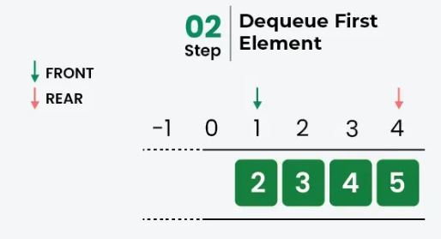

Slide 44
3. Peek or Front Operation:
This operation returns the element at the front end without removing it.
4. Size Operation:
This operation returns the numbers of elements present in the queue.
5. isEmpty Operation:
This operation returns a boolean value that indicates whether the queue is empty or not.
6. isFull Operation:
This operation returns a boolean value that indicates whether the queue is full or not

Slide 45
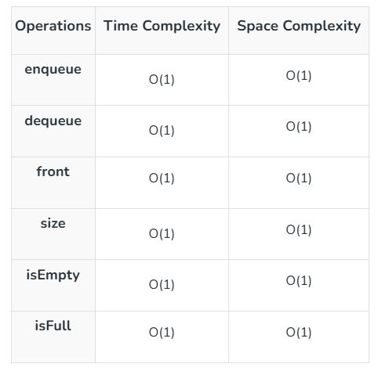

Slide 46
Applications of Queue
CPU scheduling, Disk Scheduling
When data is transferred asynchronously between two processes. The queue is used for synchronization. For example: IO Buffers, pipes, file IO, etc
Handling of interrupts in real-time systems.
Call Center phone systems use Queues to hold people calling them in order.

Slide 47
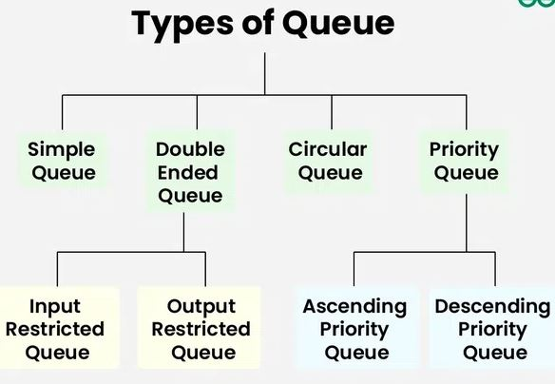
Types of Queues

Slide 48
Circular Queue
A Circular Queue is another way of implementing a normal queue where the last element of the queue is connected to the first element of the queue forming a circle.
The operations are performed based on the FIFO (First In First Out) principle.
It is also called ‘Ring Buffer’.
In a normal Queue, we can insert elements until the queue becomes full.
However once the queue becomes full, we can not insert the next element even if there is a space in front of the queue.

Slide 49
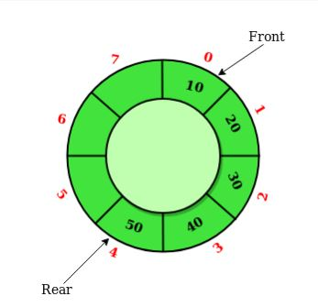

Slide 50
Operations on Circular Queue
getFront: Get the front item from the queue.
getRear: Get the last item from the queue.
enqueue(value): To insert an element into the circular queue. In a circular queue, the new element is always inserted at the rear position.
dequeue(): To delete an element from the circular queue. In a circular queue, the element is always deleted from the front position.

Slide 51
Initialize an array of size n, where n is the maximum number of elements that the queue can hold.
Initialize three variables (size, capacity, and front.)
Enqueue: To enqueue an element x into the queue, do the following:
Check if size == capacity (queue is full), display “Queue is full”.
If not full: calculate rear = (front + size) % capacity and Insert value at the rear index. Increment size by 1

Slide 52
Dequeue: To dequeue an element from the queue, do the following:
Check if size == 0 (queue is empty), display “Queue is empty”.
If not empty: retrieve the element at the front index and move front = (front + 1) % capacity. Also, decrement size by 1 and return the removed element.

Slide 53
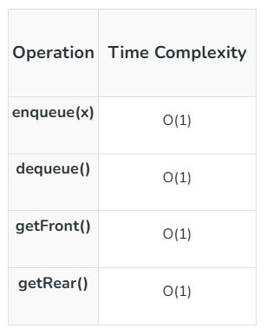

Slide 54
Priority Queue
A priority queue is a type of queue that arranges elements based on their priority values.
Each element has a priority associated. When we add an item, it is inserted in a position based on its priority.
Elements with higher priority are typically retrieved or removed before elements with lower priority.

Slide 55
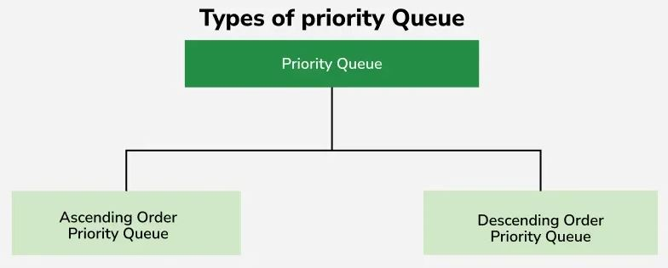

Slide 56
Ascending Order Priority Queue : In this queue, elements with lower values have higher priority. For example, with elements 4, 6, 8, 9, and 10, 4 will be dequeued first since it has the smallest value, and the dequeue operation will return 4.
Descending order Priority Queue : Elements with higher values have higher priority. The root of the heap is the highest element, and it is dequeued first. The queue adjusts by maintaining the heap property after each insertion or deletion.

Slide 57
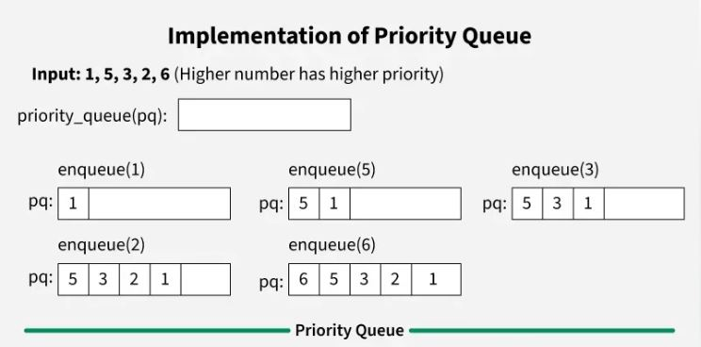

Slide 58
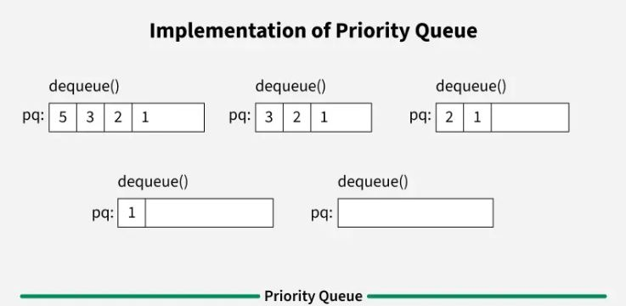

Slide 59

Deque or Double-ended queue
Deque or Double Ended Queue is a generalized version of Queue data structure that allows insert and delete at both ends.
it does not follow FIFO rule (First In First Out).

Slide 60
Types of Deque
Input Restricted Deque In this deque, input is restricted at a single end but allows deletion at both the ends.
Output Restricted Deque In this deque, output is restricted at a single end but allows insertion at both the ends.

Slide 61
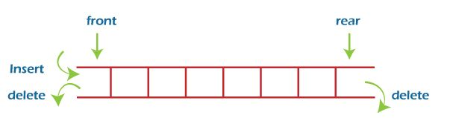
Input Restricted Deque

Slide 62
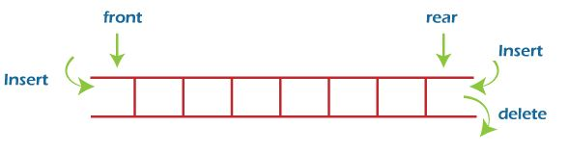
Output Restricted Deque

Slide 63
Operations on a Deque
1. Insert at the Front
2. Insert at the Rear
3. Delete from the Front
4. Delete from the Rear
5. Check Empty
6. Check Full

Slide 64
Insert at the Front
In this operation, the element is inserted from the front end of the queue. Before implementing the operation, we first have to check whether the queue is full or not. If the queue is not full, then the element can be inserted from the front end by using the below conditions -
If the queue is empty, both rear and front are initialized with 0. Now, both will point to the first element.
Otherwise, check the position of the front if the front is less than 1 (front < 1), then reinitialize it by front = n - 1, i.e., the last index of the array.

Slide 65
Insert at the Rear
In this operation, the element is inserted from the rear end of the queue. Before implementing the operation, we first have to check again whether the queue is full or not. If the queue is not full, then the element can be inserted from the rear end by using the below conditions -
If the queue is empty, both rear and front are initialized with 0. Now, both will point to the first element.
Otherwise, increment the rear by 1. If the rear is at last index (or size - 1), then instead of increasing it by 1, we have to make it equal to 0.

Slide 66
Delete from the Front
In this operation, the element is deleted from the front end of the queue. Before implementing the operation, we first have to check whether the queue is empty or not.
If the queue is empty, i.e., front = -1, it is the underflow condition, and we cannot perform the deletion. If the queue is not full, then the element can be inserted from the front end by using the below conditions -
If the deque has only one element, set rear = -1 and front = -1.
Else if front is at end (that means front = size - 1), set front = 0.
Else increment the front by 1, (i.e., front = front + 1).

Slide 67
Delete from the Rear
In this operation, the element is deleted from the rear end of the queue. Before implementing the operation, we first have to check whether the queue is empty or not.
If the queue is empty, i.e., front = -1, it is the underflow condition, and we cannot perform the deletion.
If the deque has only one element, set rear = -1 and front = -1.
If rear = 0 (rear is at front), then set rear = n - 1.
Else, decrement the rear by 1 (or, rear = rear -1).

Slide 68
Check Empty
This operation is performed to check whether the deque is empty or not. If front = -1, it means that the deque is empty.
Check Full
This operation is performed to check whether the deque is full or not. If front = rear + 1, or front = 0 and rear = n - 1 it means that the deque is full.

Slide 69
Applications of deque
Deque can be used as both stack and queue, as it supports both operations.
Deque can be used as a palindrome checker means that if we read the string from both ends, the string would be the same.

